Slide 1
Unit – 4 Open Source Communities & Development Process
By:- Jatin Sethi
jsethi@ddn.upes.ac.in

Slide 2
Open Source Initiative
Eric S. Raymond paper “The Cathedral and the Bazaar” had a galvanizing effect because it articulated a clear technical and behavioral logic with which the open source community could identify.
And his subsequent presentation at O'Reilly Perl Conference which triggered Netscape the then popular web browser to release the source code.
OSI was jointly founded by Eric Raymond and Bruce Perens in late February 1998.
The Open Source Definition was derived from the Debian Free Software Guidelines.
Bruce Perens had initially drafted it and was refined using suggestions of the Debian GNU/Linux Distribution developers.

Slide 3
Open Source Definition
The Open Source Definition includes:
1. Free Redistribution
The license shall not restrict any party from selling or giving away the software as a component of an aggregate software distribution containing programs from several different sources. The license shall not require a royalty or other fee for such sale.
2. Source Code
The program must include source code, and must allow distribution in source code as well as compiled form. Where some form of a product is not distributed with source code, there must be a well-publicized means of obtaining the source code for no more than a reasonable reproduction cost preferably, downloading via the Internet without charge. The source code must be the preferred form in which a programmer would modify the program. Deliberately obfuscated source code is not allowed. Intermediate forms such as the output of a preprocessor or translator are not allowed.

Slide 4
Open Source Definition
3. Derived Works
The license must allow modifications and derived works, and must allow them to be distributed under the same terms as the license of the original software.
4. Integrity of The Author's Source Code
The license may restrict source-code from being distributed in modified form only if the license allows the distribution of "patch files" with the source code for the purpose of modifying the program at build time. The license must explicitly permit distribution of software built from modified source code. The license may require derived works to carry a different name or version number from the original software.

Slide 5
Open Source Definition
5. No Discrimination Against Persons or Groups
The license must not discriminate against any person or group of persons.
6. No Discrimination Against Fields of Endeavor
The license must not restrict anyone from making use of the program in a specific field of endeavor. For example, it may not restrict the program from being used in a business, or from being used for genetic research.
7. Distribution of License
The rights attached to the program must apply to all to whom the program is redistributed without the need for execution of an additional license by those parties.

Slide 6
Open Source Definition
8. License Must Not Be Specific to a Product
The rights attached to the program must not depend on the program's being part of a particular software distribution. If the program is extracted from that distribution and used or distributed within the terms of the program's license, all parties to whom the program is redistributed should have the same rights as those that are granted in conjunction with the original software distribution.
9. License Must Not Restrict Other Software
The license must not place restrictions on other software that is distributed along with the licensed software. For example, the license must not insist that all other programs distributed on the same medium must be open-source software.
10. License Must Be Technology-Neutral
No provision of the license may be predicated on any individual technology or style of interface.

Slide 7
The License Review Process
The purpose of OSI license review process is to ensure approved licenses conform to the Open Source Definition,
falls under appropriate License proliferation Category (to know more on this please visit http://opensource.org/proliferation-report),
avoid duplication and
transparent and timely review.
Request Submission:
Retirement - A request retire the license. This request can only be made by the license steward
Legacy Approval - Retroactive approval of historic/legacy licenses that have already been extensively used by an existing community, but have not previously been approved.
Approval - Approval of completely new licenses, or licenses previously used by only a single entity
Review:
The license review community will discuss for at least 30 days. Then, License Review Chair will summarize and present recommendations to OSI Board which will request additional information if need be and make final decision. A report will be submitted to License review committee which will approve or reject.

Slide 8
Free Software Foundation(FSF)
Non-profitable organization founded in 1985 by Richard Stallman.
The primary motive is to promote freedom to use, modify and distribute software.
FSF management consist of, Richard Stallman as President, John Sullivan, Executive Director and Ward Vandewege, Chief Technology Officer.
FSF has over 3,000 active members in 48 countries, representing a diverse membership of computer users, artists, software engineers, hackers, students, and activists.

Slide 9
FSF Contd...
The FSF sponsors the GNU project.
The ongoing effort to provide a complete operating system licensed as free software.
They work around GNU GPL and free software licensing, and enforcing the license on FSF-copyrighted software.
The FSF publishes the GNU General Public License (GNU GPL), widely used free software license.
FSF is copy-left based movement.

Slide 10
Free Software Foundation of India
It is an Indian sister organization to the US-based Free Software Foundation.
FSFI was founded in Thiruvananthapuram, Kerala in 2001.
They have been working with many scientist and professionals to promote open source software.

Slide 11
Vision of FSF India
Promote awareness about free software among the general public and, specifically, among programmers and students.
Increase access to free software by users in India.
Promote the development of local solutions to local problems by empowering local programmers in the use of free platforms, tools and technologies.
Provide support to free software by way of documentation, expert help or any other means.
Help organize training for programmers and users of free software platforms and software.

Slide 12
Vision of FSF India
Carry out R&D work for free software solutions to suit local requirements.
Provide services for the free software programmer community by, for example, locating and distributing jobs.
Assist the national and State governments in all aspects relating to free software, such as evolving and maintaining standards; providing a quality assurance mechanism for free software; and ensuring the use of free software in government and quasi-government milieux.
Provide services such as adjudication and conflict redressal within the free software domain.

Slide 13
Open Source Development Process
Call for contribution-Br Richard Stallman
“Starting this Thanksgiving I am going to write a complete Unix-compatible software system called GNU (for Gnu's Not Unix), and give it away free to everyone who can use it. Contributions of time, money, programs and equipment are greatly needed”
displayed to user who logged into Usenet newsgroup during the spring of 1983.

Slide 14
Open Source Development Process
It is the process by which open-source software, or similar software whose source code is publicly available and is developed.

Slide 15
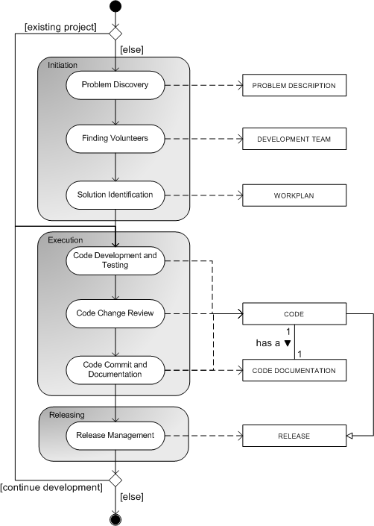
from Sharma et al

Slide 16
Open Source Development Process
There are several ways in which work on an open-source project can start:
An individual who senses the need for a project announces the intent to develop a project in public.
A developer working on a limited but working codebase, releases it to the public as the first version of an open-source program.
The source code of a mature project is released to the public.
A well-established open-source project can be forked by an interested outside party.

Slide 17
Myth Buster
Myth #1: Open Source is unreliable.
Myth #2: Open Source software are not well supported.
Myth #3: Open Source is not just meant for big companies

Slide 18
Myth Buster
Eric S. Raymond the author of “Cathedral and the Bazaar” pointed 2 kinds of software development. The first is like building a cathedral, with complete planning from start to finish this was followed in closed source development. This was more or less followed by FSF. Eric also observed in one of the conference delivered by Richard Stallman and Linux Torvalds, where Torvalds had found a way around Brook’s Law
CatB is an essay, and later a book, by Eric S. Raymond on software engineering methods, based on his observations of the Linux kernel development process and his experiences managing an open source project, fetchmail.

Slide 19
Brook’s Law:
Brooks' law is a claim about software project management according to which "adding manpower to a late software project makes it later". It was coined by Fred Brooks in his 1975 book The Mythical Man-Month.
According to Brooks, there is an incremental person who, when added to a project, makes it take more, not less time.

Slide 20
Brook’s Law:
Brooks points to two main factors that explain why it works this way:
It takes some time for the people added to a project to become productive. Brooks calls this the "ramp up" time.
Software projects are complex engineering endeavors,
new workers on the project must first become educated about the work that has preceded them;
this education requires diverting resources already working on the project, temporarily diminishing their productivity while the new workers are not yet contributing meaningfully.
Each new worker also needs to integrate with a team composed of several engineers who must educate the new worker in their area of expertise in the code base, day by day.
In addition to reducing the contribution of experienced workers (because of the need to train), new workers may even make negative contributions, for example, if they introduce bugs that move the project further from completion.

Slide 21
Brook’s Law:
Brooks points to two main factors that explain why it works this way:
Communication overheads increase as the number of people increases.
Due to combinatorial explosion, the number of different communication channels increases rapidly with the number of people.
Everyone working on the same task needs to keep in sync, so as more people are added they spend more time trying to find out what everyone else is doing.

Slide 22
Exceptions and possible solutions
Brooks' law is often cited to justify why projects keep being late, despite management efforts. However, there are some key points in Brook's law that allow exceptions and open the door for possible solutions.
Projects can be brought back into (or kept in) control if people are added earlier in the process
Correcting the schedule is the best way to have a meaningful and reliable time frame for the project's completion.
The quantity, quality and role of the people added to the project also must be taken into consideration.

Slide 23
Exceptions and possible solutions
Good programmers or specialists can be added with less overhead for training.
People can be added to do other tasks related with the project, for example, quality assurance or documentation; given that the task is clear, ramp up time is minimized.
Good management and development practices also help to minimize the impact of Brooks' law.
The modern practices of continuous integration, test-driven development, and iterative development significantly reduce the inter-developer communication overhead, and thus allow for better scalability.

Slide 24
Exceptions and possible solutions
New tools for software development and documentation also help to minimize the ramp up time, making it simpler for new programmers to get involved in the work
Design patterns simplify the distribution of work

Slide 25
Apache Web Server
A web server is a computer system that processes requests via HTTP, the basic network protocol used to distribute information on the World Wide Web. The term can refer either to the entire system, or specifically to the software that accepts and supervises the HTTP requests.
A web server is a computer that stores websites on the Internet and delivers web pages to the requester.
The primary function of a web server is to store, process and deliver web pages to clients.

Slide 26
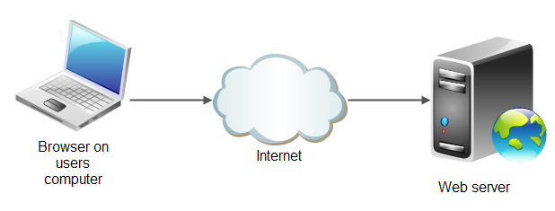

Slide 27
Apache Web Server
The Apache HTTP Server, is the world's most used web server software. Originally based on the NCSA HTTPd server(By Rob McCool), development of Apache began in early 1995 after work on the NCSA code stalled.
Apache played a key role in the initial growth of the World Wide Web, quickly overtaking NCSA HTTPd as the dominant HTTP server.
first web server software to serve more than 100 million websites
Notes:
National Center for Supercomputing Applications (NCSA)
httpd is the Apache HyperText Transfer Protocol (HTTP) server program. It is designed to be run as a standalone daemon process. When used like this it will create a pool of child processes or threads to handle requests.

Slide 28

Apache Web Server
Apache is developed and maintained by an open community of developers under the auspices of the Apache Software Foundation.
The all-volunteer ASF develops, stewards, and incubates more than 350 Open Source projects and initiatives that cover a wide range of technologies
The Apache Software Foundation
provides support for the Apache Community of open-source software projects, which provide software products for the public good.

Slide 29
Apache Web Server
Most commonly used on a Unix-like system (usually GNU/Linux)
The software is available for a wide variety of operating systems, including eComStation, Microsoft Windows, NetWare, OpenVMS, OS/2, and TPF.
Released under the Apache License,
As of June 2013, Apache was estimated to serve 54.2% of all active websites and 53.3% of the top servers across all domains.

Slide 30
Apache Software Foundation
Established in 1999, the ASF is a US 501(c)(3) charitable organization, funded by individual donations and corporate sponsors.
The ASF provides an established framework for intellectual property and financial contributions that simultaneously limits potential legal exposure for apache’s project committers.
Through the ASF's meritocratic process known as "The Apache Way," more than 500 individual Members and 4,500 Committers successfully collaborate to develop freely available enterprise-grade software, benefiting millions of users worldwide:
thousands of software solutions are distributed under the Apache License;
and the community actively participates in ASF mailing lists, mentoring initiatives, and ApacheCon, the Foundation's official user conference, trainings, and expo.

Slide 31
ASF Contd...
It has multiple projects under its umbrella namely, Jakarta, Perl, TCL, and others.
People are given access to code repository based on the individual merits.
This worked well because most of the contributors are volunteers who wanted to help by bringing in few features or fixing a bug.

Slide 32
ASF Contd...
User:
that uses our software.
contribute to the Apache projects by
providing feedback to developers
bug reports
and feature suggestions.
participate in the Apache community by
helping other users on mailing lists
and user support forums.
Developer:
user who contributes to a project in the form of code or documentation.
take extra steps to participate in a project,
are active on the developer mailing list,
participate in discussions;
provide patches, documentation, suggestions, and criticism.
Developers are also known as contributors.

Slide 33
ASF Contd...
Committer
Is a developer that was given write access to the code repository
and has a signed Contributor License Agreement (CLA) on file.
They have an apache.org mail address.
Not needing to depend on other people for the patches,
making short-term decisions for the project.
The PMC can agree and approve it into permanency, or they can reject it.
Remember that the PMC makes the decisions, not the individual people.

Slide 34
ASF Cont….
PMC Member
is a developer or a committer that was elected due to merit for the evolution of the project and demonstration of commitment.
They have write access to the code repository,
an apache.org mail address,
the right to vote for the community-related decisions
and the right to propose an active user for committer ship.
The PMC as a whole is the entity that controls the project, nobody else.

Slide 35
ASF Contd...
PMC Chair
is appointed by the Board from the PMC Members.
PMC is the entity that controls and leads the project.
The Chair is the interface between the Board and the Project.
ASF Member
is a person who was nominated by current members and elected due to merit for the evolution and progress of the foundation.
Members care for the ASF itself. This is usually demonstrated through the roots of project-related and cross-project activities.
Legally, a member is a "shareholder" of the foundation, one of the owners.
right to elect the board, to stand as a candidate for the board election and to propose a committer for membership.
They also have the right to propose a new project for incubation.

Slide 36
ASF Contd...
Project Management and Collaboration
The Apache projects are managed using a collaborative, consensus-based process.
Since the appointed Project Management Committees (PMC) have the power to create their own self-governing rules,
there is no single vision on how PMCs should run a project and the communities they host.
At the same time, while there are some differences, there are a number of similarities shared by all the projects:

Slide 37
ASF Contd...
Communication
done via mailing lists.
Where conversations happens asynchronously.
Some projects additionally use more instant messaging for synchronous communication.
Each project is responsible for its own project website.
Decision Making
Projects are normally auto governing and driven by the people who volunteer for the job.

Slide 38




Appointed by the Board
a developer or a committer that was elected due to merit
Have write access to the code repository
PMC
Committers
Take short term decisions
Have write access to the code repository
Developers
Fixes Bugs
Coding and Distributions
The one who uses
Provides feedback to the developer
Sends Bug Reports
Uses

